Slide 1

Association of Energy Engineers
New England Chapter

Slide 2
Background
Services
Opportunities

Slide 3

Association of Energy Engineers
Founded 1977
Over 16,000 individual members
140 Corporate members
22 Certifications (CEM, etc.)
Education/Seminars/Webinars
Books/Newsletters/Journals
Conferences
88 Local Chapters ( )
Mission: “to promote the scientific and educational interests of those engaged in the energy industry and to foster action for Sustainable Development.”

Slide 4
Chapter formed 1980
Over 700 individual members
42 Corporate Sponsors
Annual CEM class
Monthly meetings/tours (~ 9/year)
Technical Roundtables
Scholarships
Student Chapters
Volunteer opportunities/networking

Slide 5
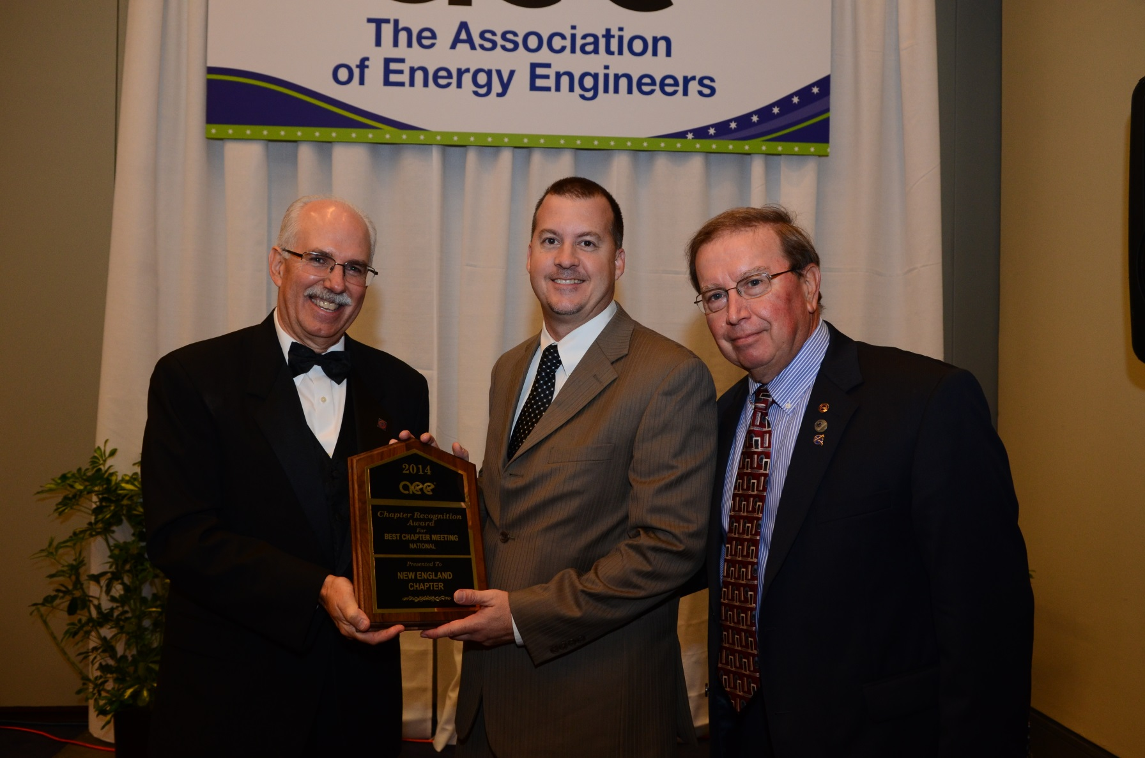

Slide 6



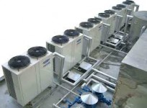
November 5, 2014
Careers in Energy Efficiency & Clean Tech
____________
Scholarship Awards
November 3 -7, 2014
5-Day Certified Energy Manager Training
__________
Siemens - Canton, MA
November 17, 2014
Technical Roundtable
Heat Pump Applications
______________
CSG – Westborough, MA

Slide 7

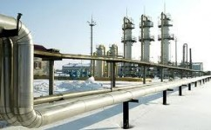
December 3, 2014
Effective Sales Techniques for Energy Efficiency Projects
January 7, 2015
Annual Energy
Outlook Forum
_____________
Raytheon - Waltham
www.aeenewengland.org

